Slide 1
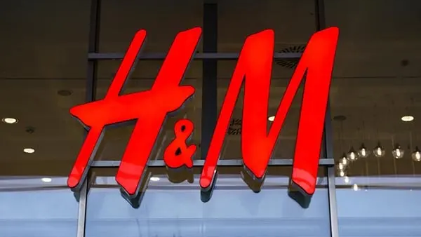
Presented by:
Divya Padala
Dhruvi Naik
Gowtham Pala
Nimit Taswala

Slide 2
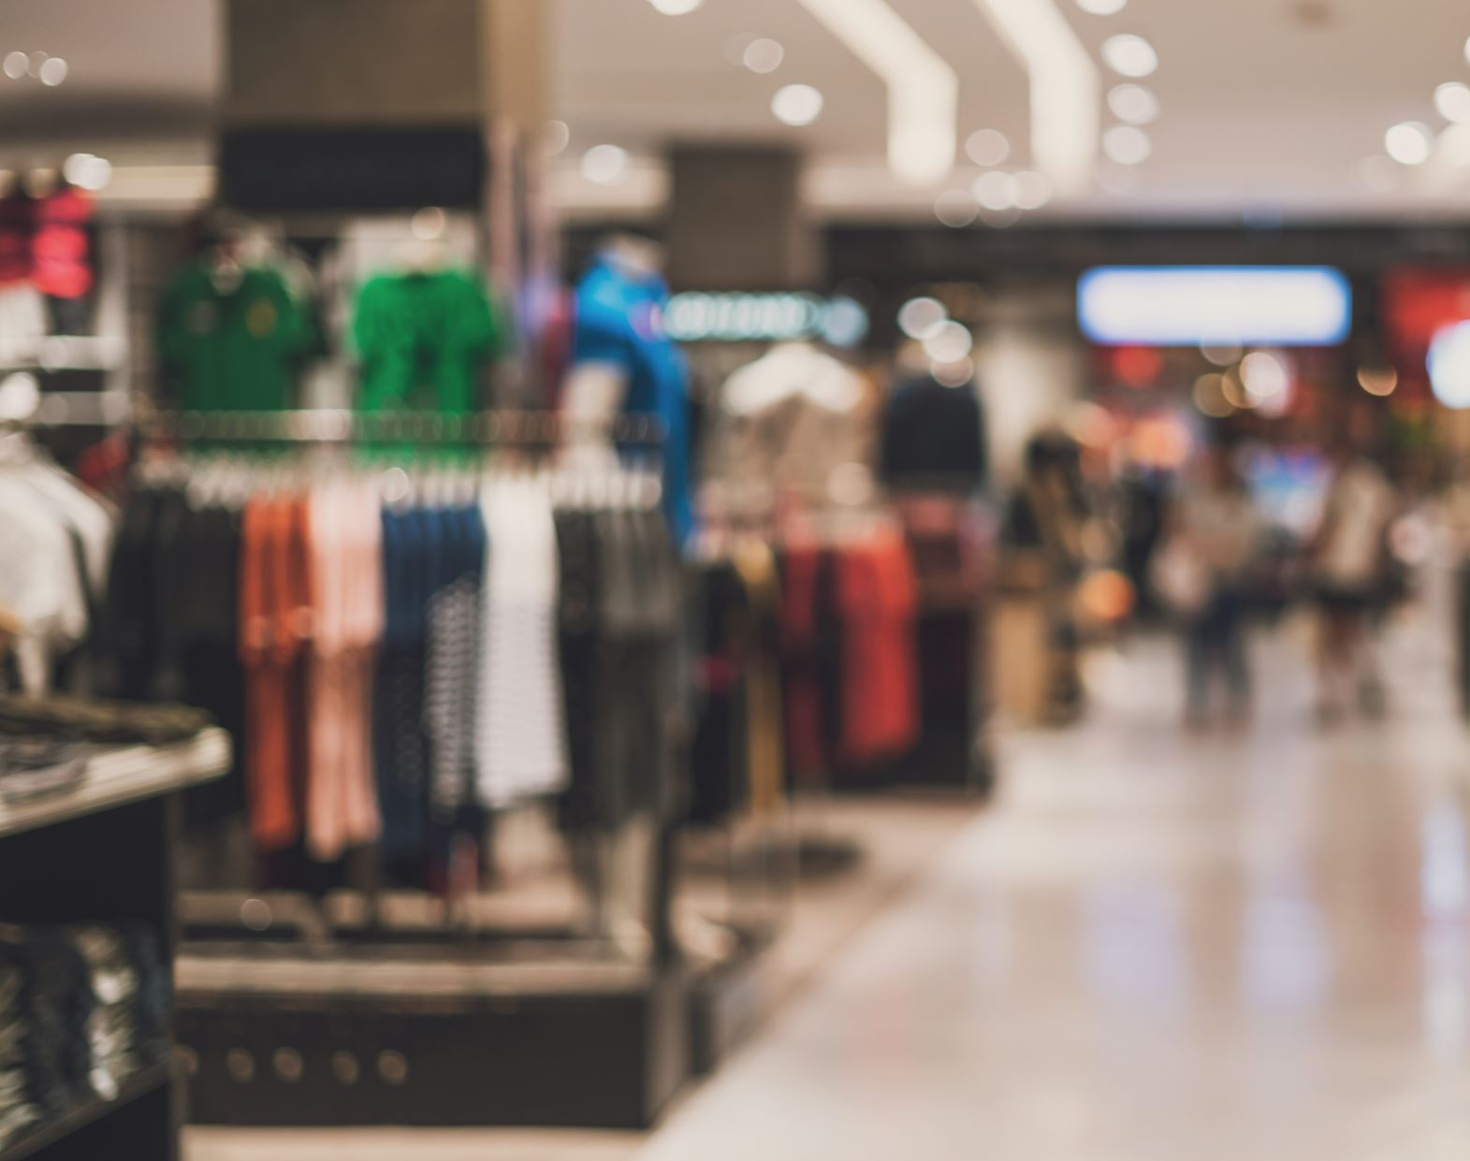
H&M’s Operational Innovations in the Fashion Retail Industry
“Leveraging sustainability, Technology, and Demand Forecasting for Efficiency”

Slide 3
H&M’s Operational Innovations
H&M is a global leader in the fast-fashion industry, known not only for its affordable and trendy clothing but also for its commitment to operational excellence. The company stands out for integrating sustainability, customer experience, and advanced technology into its retail operations.
In this presentation, we will focus on three main areas where H&M has innovated:
~ Sustainability in the supply chain: through recycling, responsible sourcing, and sustainable materials.
~ Automated checkout and mobile payment options: implemented to streamline the shopping experience.
~ Demand forecasting: using data analytics to manage inventory and meet consumer demands.

Slide 4
~ Sustainability Initiatives in the Supply Chain
One of H&M’s most impactful innovations is its commitment to sustainability within its supply chain.
Key initiatives include:
Recycling Programs: H&M allows customers to bring in old clothes for recycling. These materials are often used in their “Conscious” collection, which promotes eco-friendly fashion.
Sustainable Materials: H&M uses recycled materials, like recycled polyester, and organic options, like organic cotton. These sustainable materials reduce environmental impact.
Circular Fashion: The goal is to close the loop in fashion by designing products that can be reused or recycled, minimizing waste.
These initiatives have operational benefits, like reduced material costs and a more transparent supply chain. They align with H&M's commitment to being climate positive by 2040, aiming to drastically reduce emissions and environmental footprint. Through partnerships with sustainable suppliers, H&M ensures they meet ethical and environmental standards.

Slide 5
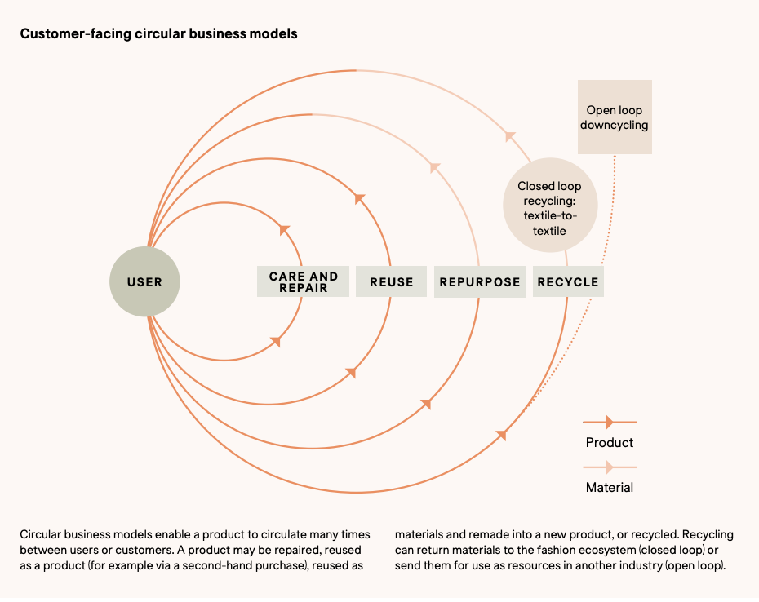
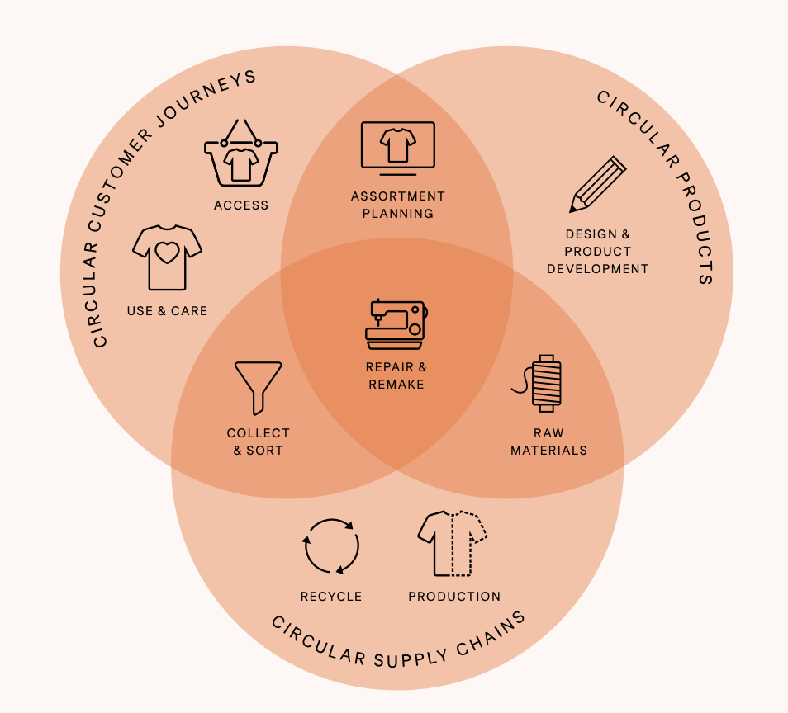

Slide 6
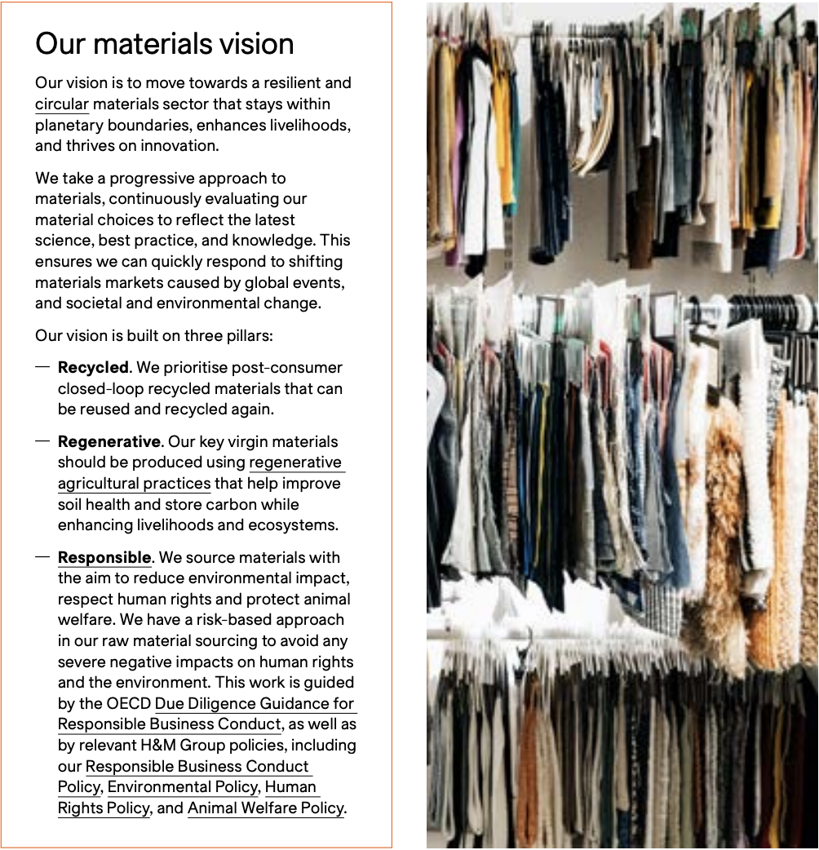

Slide 7
~ Automated Checkout & Mobile Payment Options
H&M has also integrated technology to improve the shopping experience with:
Automated Checkout: By implementing self-checkout kiosks and RFID technology, H&M has sped up the checkout process. This reduces customer wait times and makes shopping more convenient.
Mobile Payments: Customers can use contactless payment options, which became especially relevant post-pandemic. This integration supports a safer and more efficient shopping experience.
These technologies reduce the need for staff at checkout counters, allowing employees to focus on customer service. Automated checkout also cuts down on operational costs related to cash handling and labor. The initial setup is an investment, but the long-term savings in labor and increased customer satisfaction provide a solid return on investment, especially when scaled across U.S. stores.

Slide 8
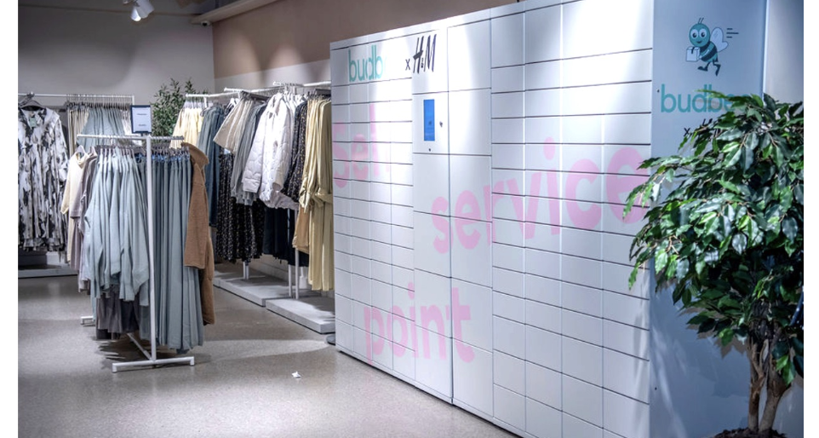
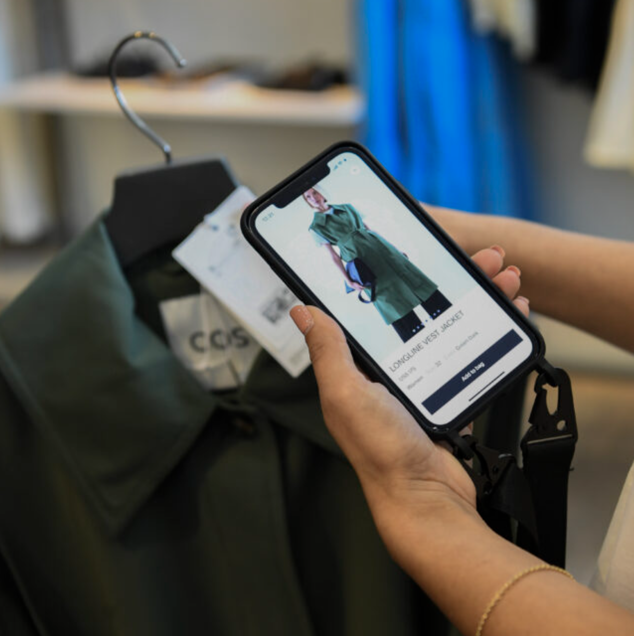

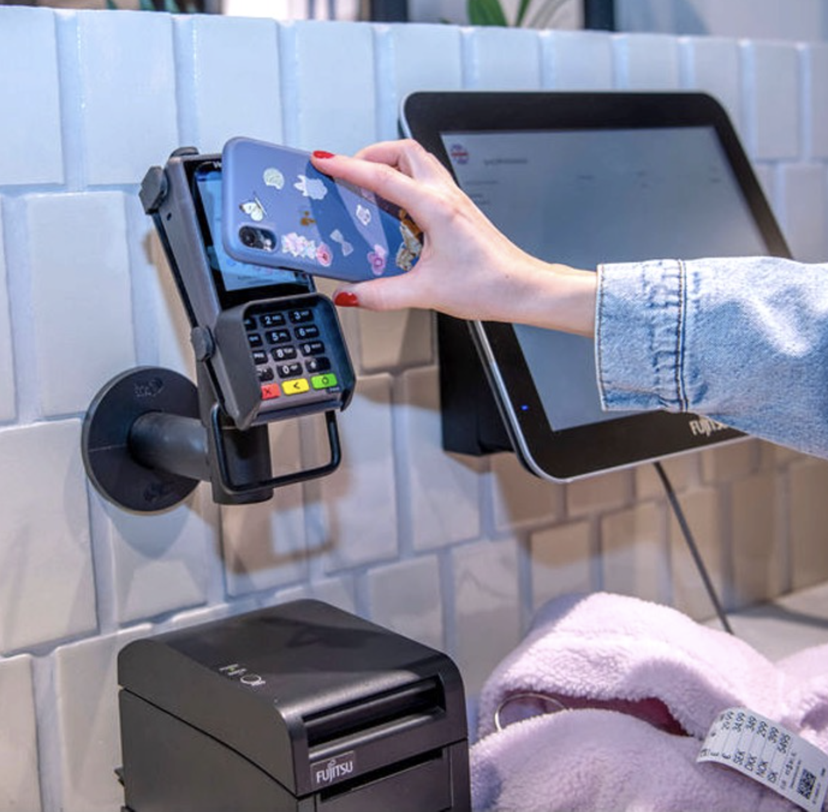

Slide 9
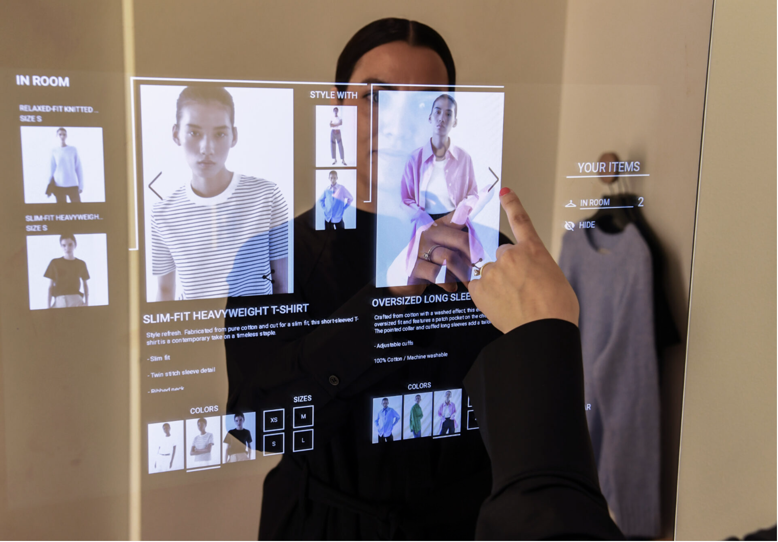
H&M Group is now rolling out a pilot in COS stores, US, where tech-enabled in-store shopping solutions provide visitors with seamless payment options, personalized styling recommendations, faster checkout, and upgraded delivery/return options. This is one example of H&M Group’s ambition to pilot new technologies that meet customers’ demands.

Slide 10
~ Approach To Fast Fashion and Demand Forecasting
To support its fast-fashion model, H&M has adopted advanced demand forecasting techniques.
Here’s how it works:
Demand Forecasting Techniques: H&M uses data analytics to predict trends and manage inventory, allowing the company to meet customer demand efficiently and reduce the risk of overstock or understock.
Comparison with Traditional Retail Models: Unlike traditional retailers that plan months in advance, H&M’s model allows it to quickly design, produce, and distribute new items in response to trends. This agility is a key factor in its success in the fast-fashion market.
Operational and Financial Impacts: This approach leads to faster inventory turnover, lower markdowns, and reduced storage costs. It also frees up cash flow and reduces the financial risk associated with unsold inventory.

Slide 11
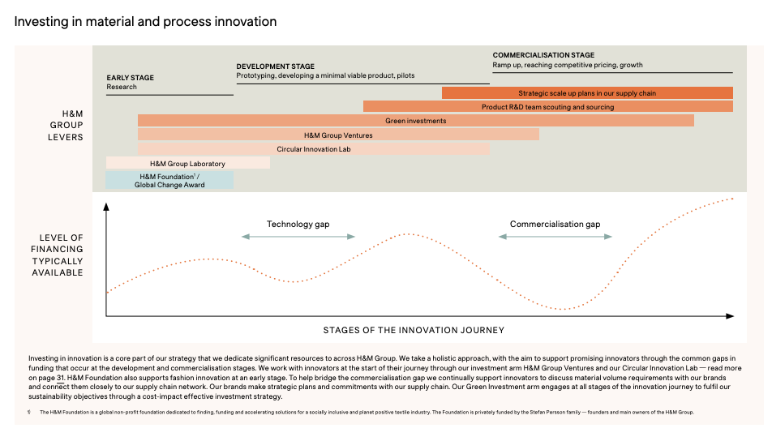

Slide 12
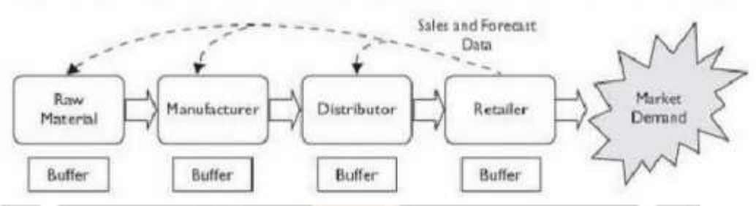
Demand Forecasting Techniques
Demand forecasting in supply chain operation plays a vital role in deciding the efficacy of a firm. Forecasting demand is a big challenge for a company.
H&M has considered its supply chain as a single entity which help them to cater to their actual demand of a product. H&M thoroughly study’s the end user demand data instead of forecasting demand based on orders received. H&M keeps an eye on uncertain events which might interrupt the manufacturing process in future so they keep their Buffer inventory ready which will not hurt production or sales. Buffer is determined by the unforeseen events in market demand and service required by the market.
H&M also uses the data from their retail stores(POS) in forecasting the demand of certain products which are favorites among customers. H&M always try to fulfill their customer’s demand effectively and efficiently and also tries to eliminate distortion in its supply chain and keeping themselves well versed with current fashion seasons.

Slide 13
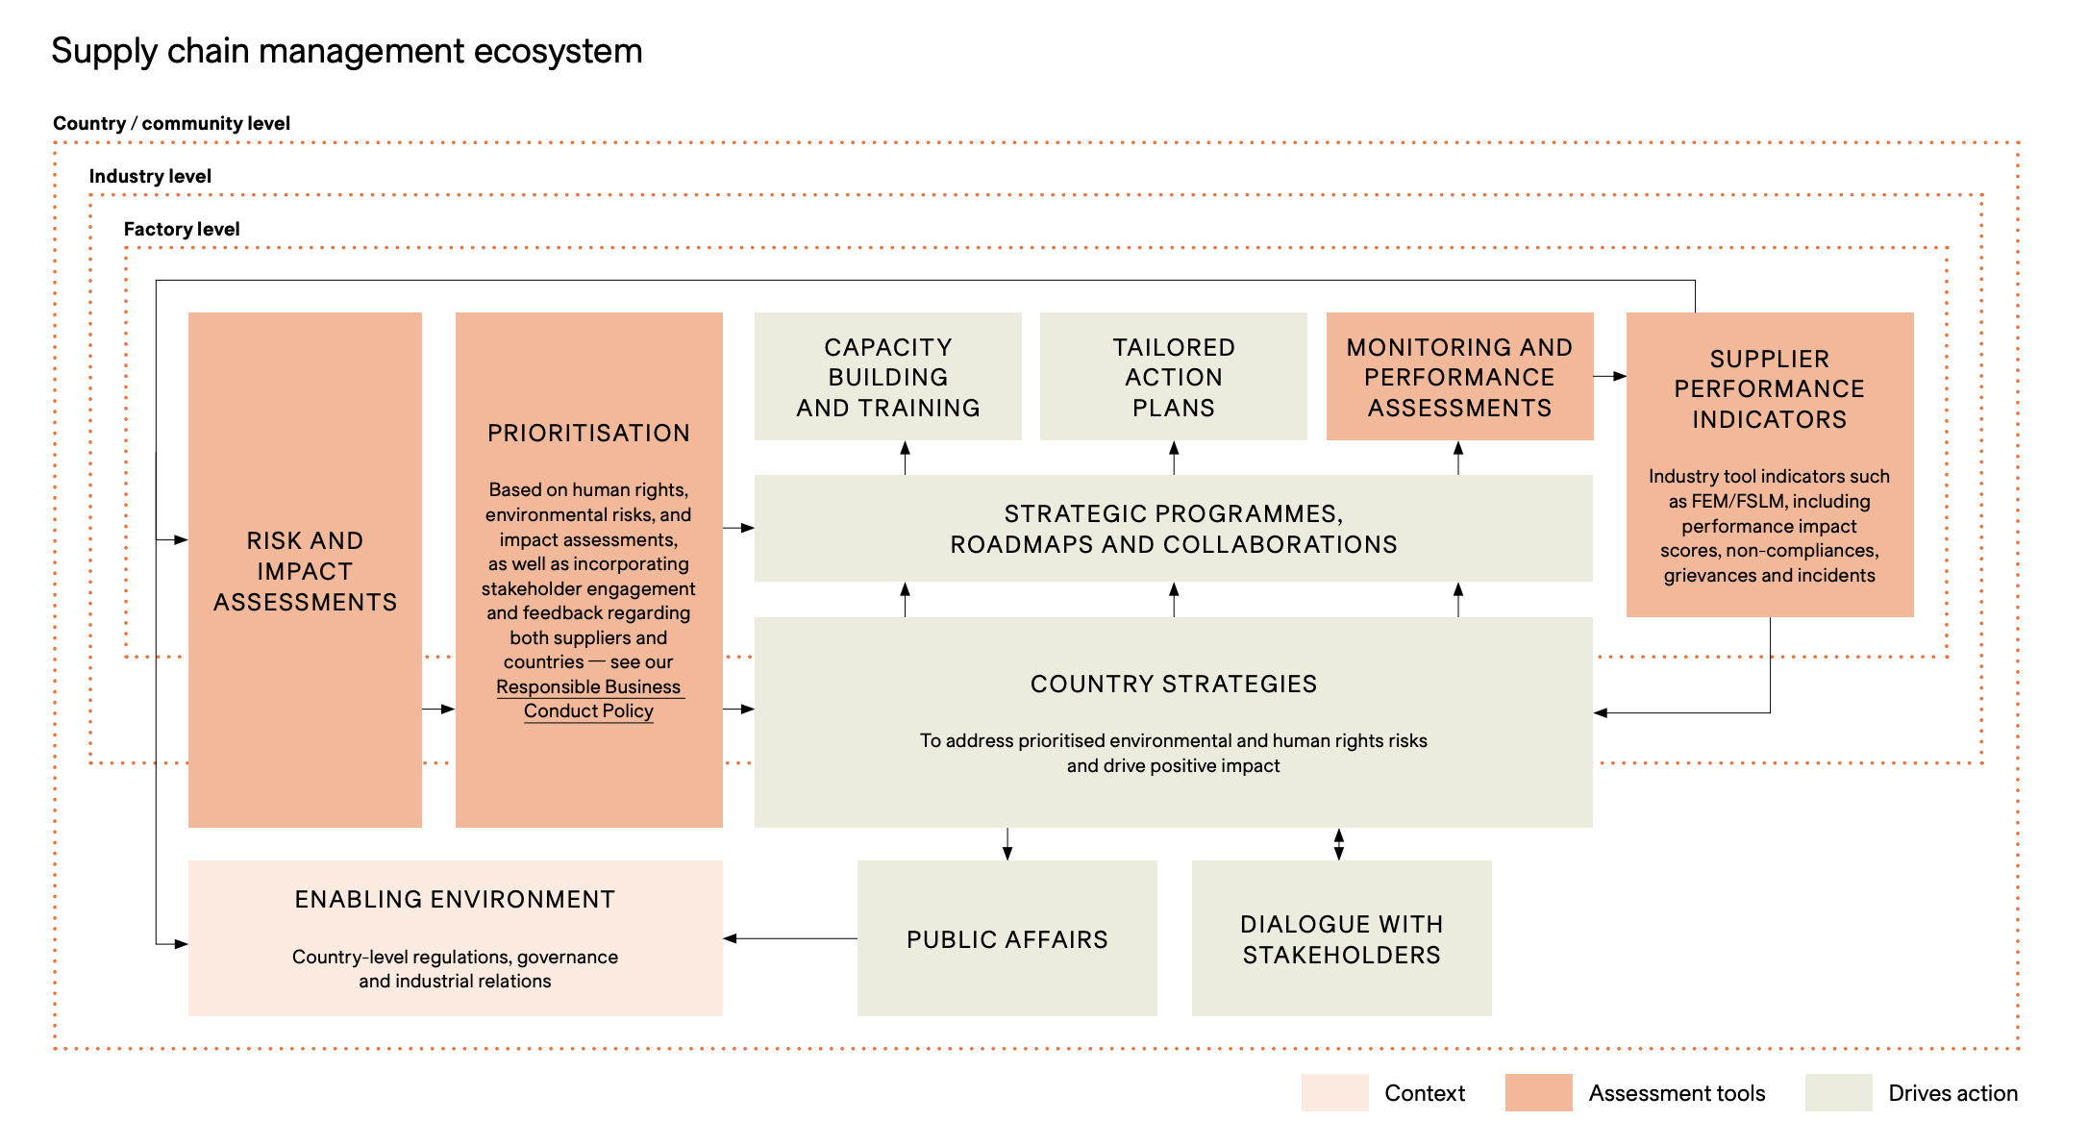

Slide 14
Financial& Environmental Impact
H&M’s innovations bring both financial and environmental benefits:
Financial Impacts: By cutting costs on materials through recycling, reducing labor needs with automation, and increasing inventory turnover, H&M achieves significant cost savings. Additionally, by enhancing the customer experience, it drives sales and builds brand loyalty.
Environmental Impacts: Through its sustainability initiatives, H&M has managed to reduce its carbon footprint by investing in energy-efficient practices and sustainable materials. The brand’s circular fashion approach helps reduce waste by encouraging recycling and reuse.
These financial and environmental benefits make H&M’s business model more resilient and contribute to its long-term growth in a market that increasingly values corporate responsibility.

Slide 15
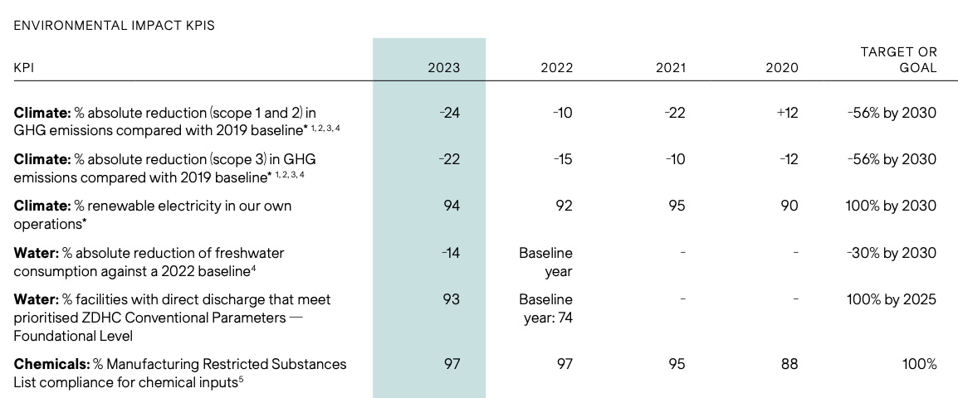

Slide 16
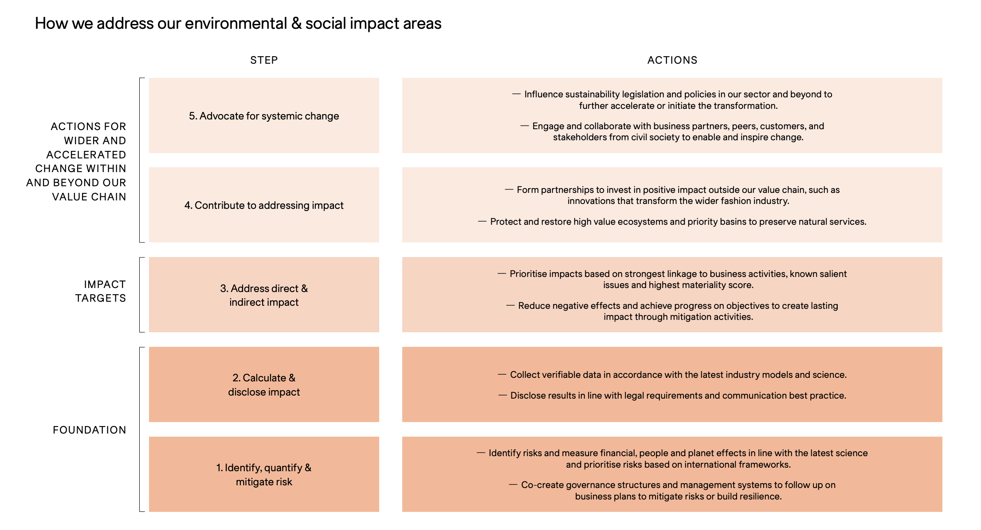

Slide 17
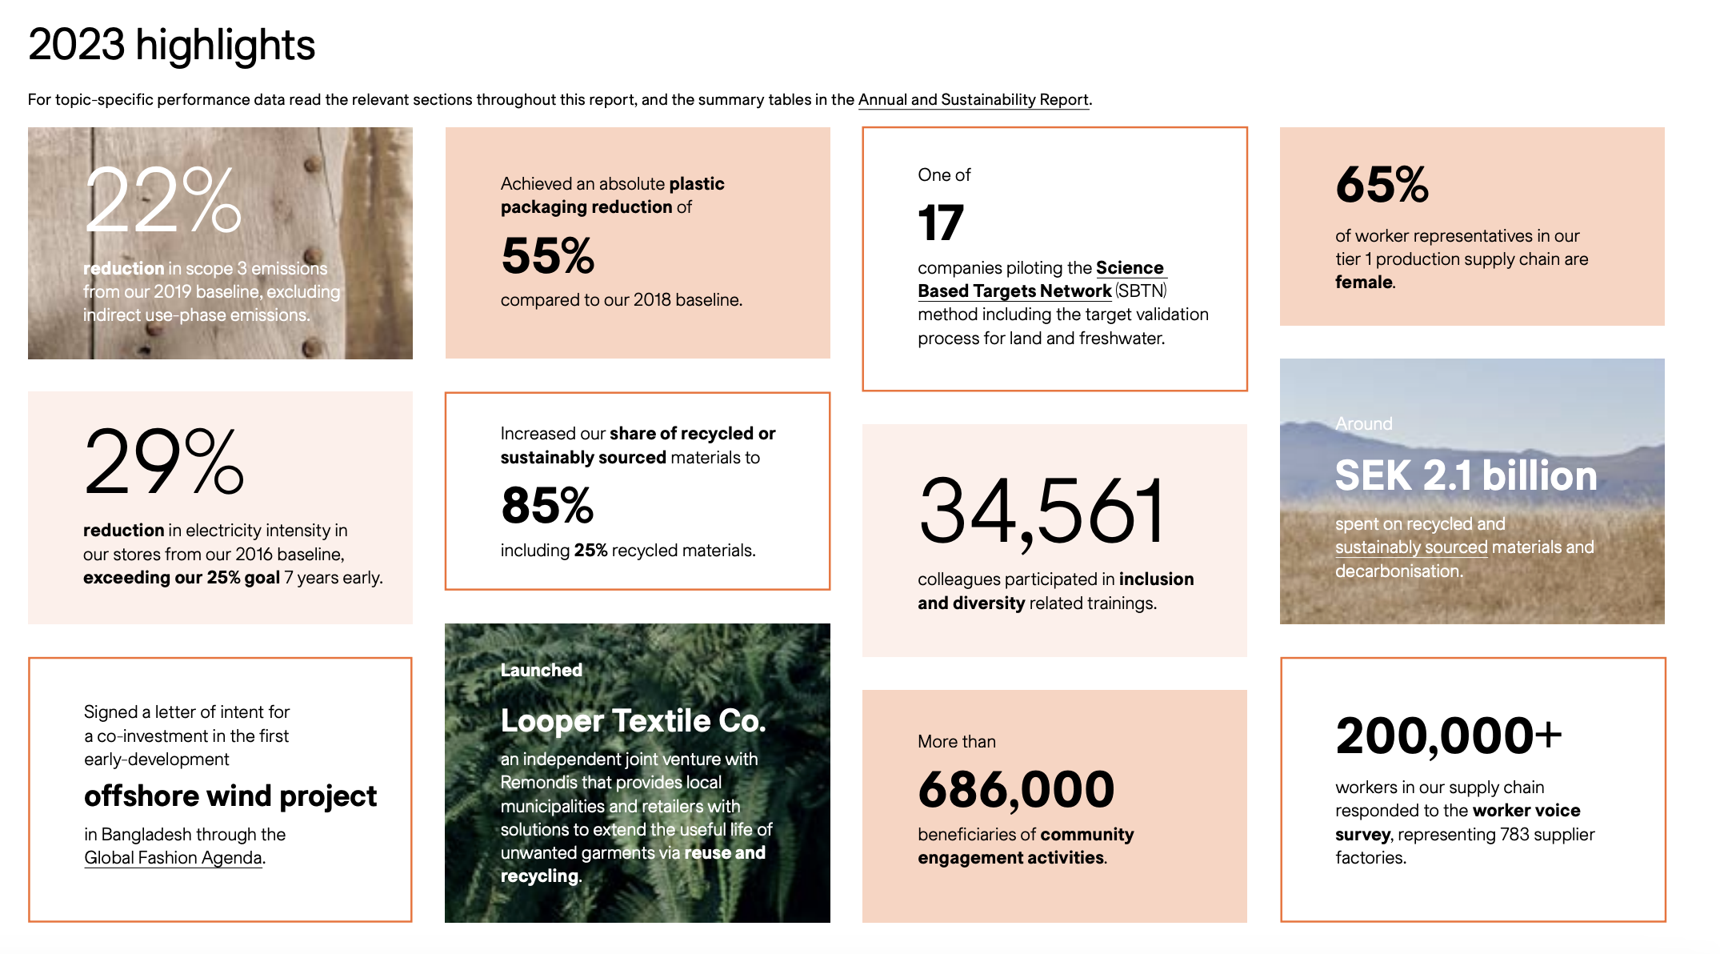

Slide 18
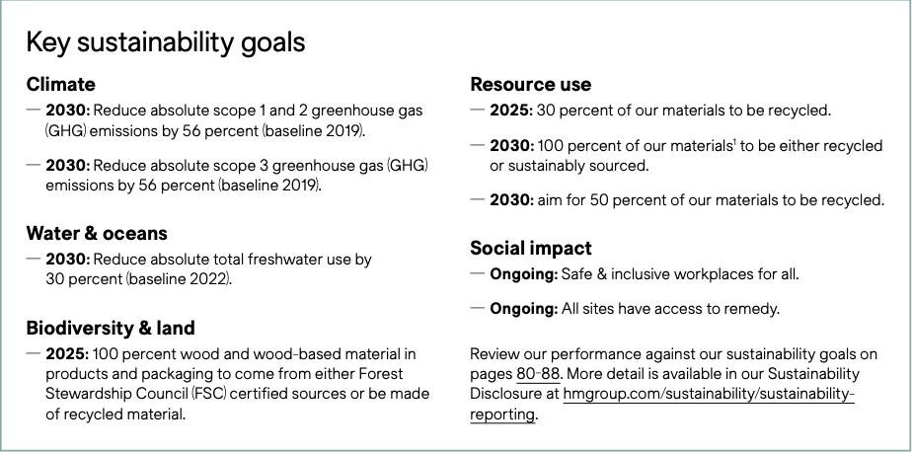

Slide 19
Summary
Key Insights: H&M’s integration of sustainability and technology demonstrates how operational innovations can enhance both profitability and brand reputation. Automated checkout, sustainability in supply chains, and demand forecasting are valuable tools that contribute to H&M’s success.
Implications for the Fashion Retail Industry: H&M’s practices could serve as a model for other retailers. By balancing profitability with sustainability, H&M has set an example for the industry on how to respond to consumer demands for ethical and efficient business practices.
Final Thoughts
As H&M continues to scale these initiatives, it will likely face challenges, especially as it expands sustainability efforts. However, its commitment to innovation has proven beneficial, and these practices are essential for H&M to remain competitive and relevant.

Slide 20
References
Here are the sources we used in our research:
Below are the reports of previous years sustainability report:
Sustainability Report 2023
Sustainability Report 2022
Below are the references:
Insight into Supply chain Strategy
Sustainability Disclosure
H&M goes Digital.
H&M Strategy.
An Analysis Of Supply Chain Management
Tech enabled shopping experiences
Sustainability & Circulatory

Slide 21
